Slide 1
The 3rd YouTube-8M Video Understanding Challenge
Yoruk Cagri Zeyu Song

Slide 2
For - Anyone uses social media
Who - Doesn't want to spend a lot of time searching moments in the video
The - 5-SEC is a convenience
That finds the important part of the videos
#Unlike - GOOGLE Our Product - has more functions to edit the videos.
Product Mission

Slide 3
Define Customers
People use social media.
People are interested in videography.
People who don't know how to edit videos.
Editing Companies that wants to use our feature.

Slide 4
User Stories
As a User, I want the highlights of my videos so that I can save time.
As a User, I want a user-friendly interface so that I can interact easily.
As a User, I want to edit my videos so that I don't have to use any other software.
As a User, I want to share my videos.
#As a User, I want my videos to be categorized so that I can find them easier.
#As a User, I want recommendation of filters for my videos based on choice of other users.

Slide 5
A Web-application that gives the highlights of a video.
Define MVP

Slide 6
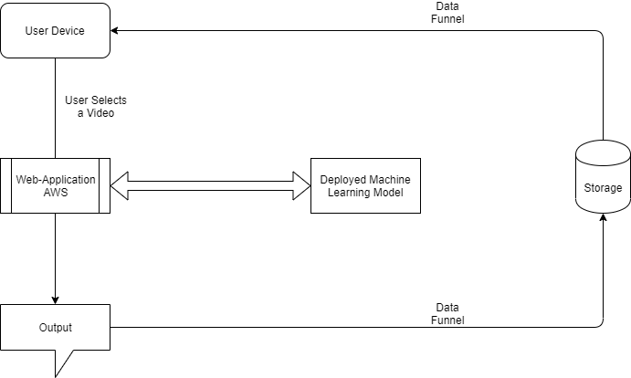
System Design

Slide 7
Youtube 8M Dataset
Frame-Level Data(Train):
Size of 1.5 TB
Each Video Has:
Id: Unique id for the video
Labels: List of labels
Each frame has rgb feature
Each frame has audio feature
Segment-Level Data(Validate/Test):
In addition to id, labels and frame level features they come with:
Segment_start_time
Segment_end_time
Segment_labels
Segment_scores
Both files are in TFRecords format which is a simple format for storing a sequence of binary records.

Slide 8
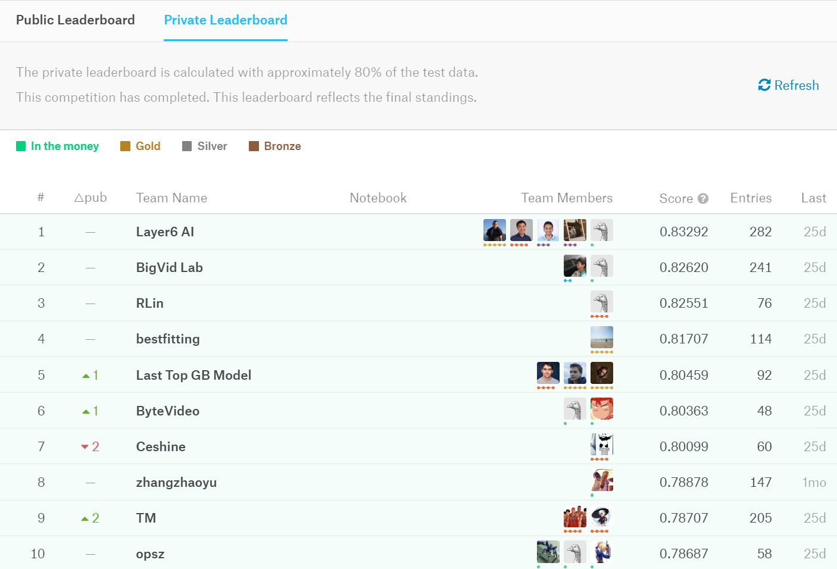
Model selection and Our Goal
Overall, frame level models;
Frame Level Logistic regression,
DBOF(Deep Bag of Frames),
LSTM(Long Short-Term Memory)
performance are better than video level model MoE(Mixture of Experts).
Our goal is to achieve 0.7 accuracy on kaggle’s test data set.

Slide 9
Trained Models
Small-Frame / 0.02 accuracy
12-Hour DBOF / Index Error
12-Hour Frame / Index Error
48-Frame level Logistic Regression Model / 0.66 accuracy
48-DBOF Model / 0.71 accuracy

Slide 10
Sprint 2 Expectations / Reality
Figure out SCC
Download the dataset
Test machine learning models
Train a model that has accuracy over %70
Test local video files and get the segments
Have enough knowledge of SCC
Downloaded the dataset
Tested ML models.
Trained a model that has accuracy of %71
Mission Failed. We’ll get them next time :)

Slide 11
DEMO

Slide 12
Sprint 3 Goals
Extract features from videos and convert them to TFRecord file
Test local videos and get the segment
Build a local application that returns the segments.

